Slide 1





Hydrothermal Alteration on Earth and Asteroids: IODP Emphasis
1
Sarah Nielsen
Mentor Dante Lauretta
Arizona Space Grant Symposium
Arizona State University in Tempe, Arizona
April 22, 2023

Slide 2
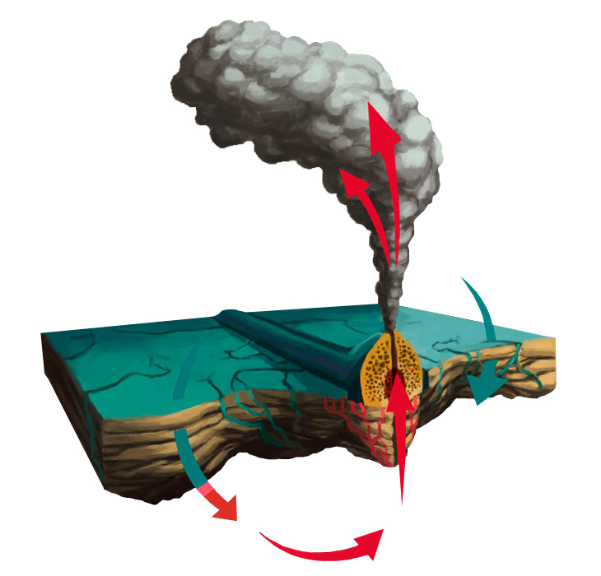
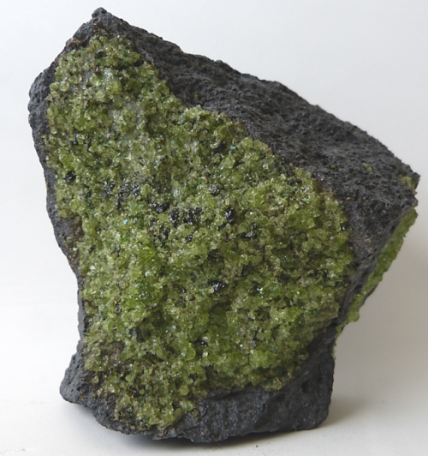
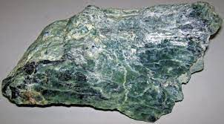
2
Hydrothermal Systems on Earth
H2O
Peridotite with olivine
Serpentine
Source: Wikimedia Commons
Source: Wikimedia Commons
Source: Lehigh News
Notes:
https://www2.lehigh.edu/news/arctic-deep-sea-expedition-like-taking-a-trip-to-the-moon

Slide 3
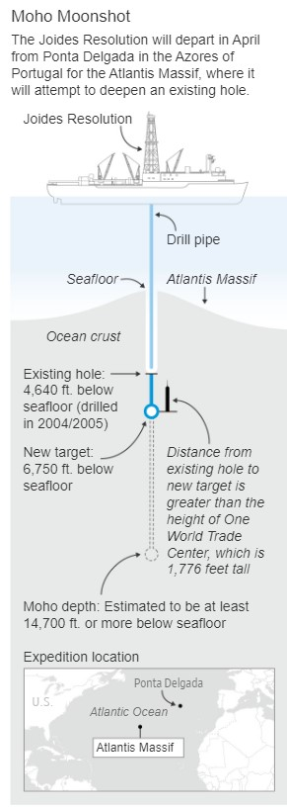
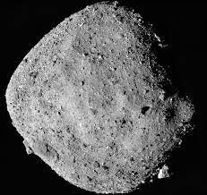
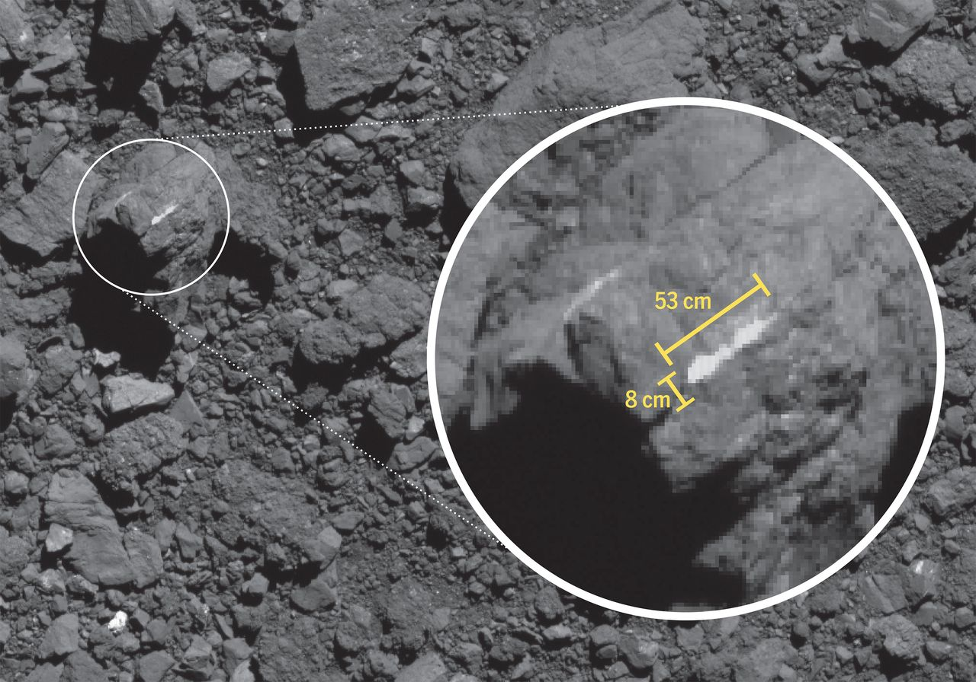
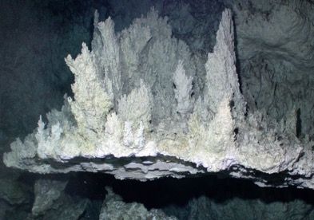
Motivation
3
Source: National Geographic
Source: NASA/University of Arizona
Carbonate on Bennu
Origins of life at hydrothermal vents
Climate change - CO2 sequestration
Source: NASA/University of Arizona
Source: Wikipedia

Slide 4

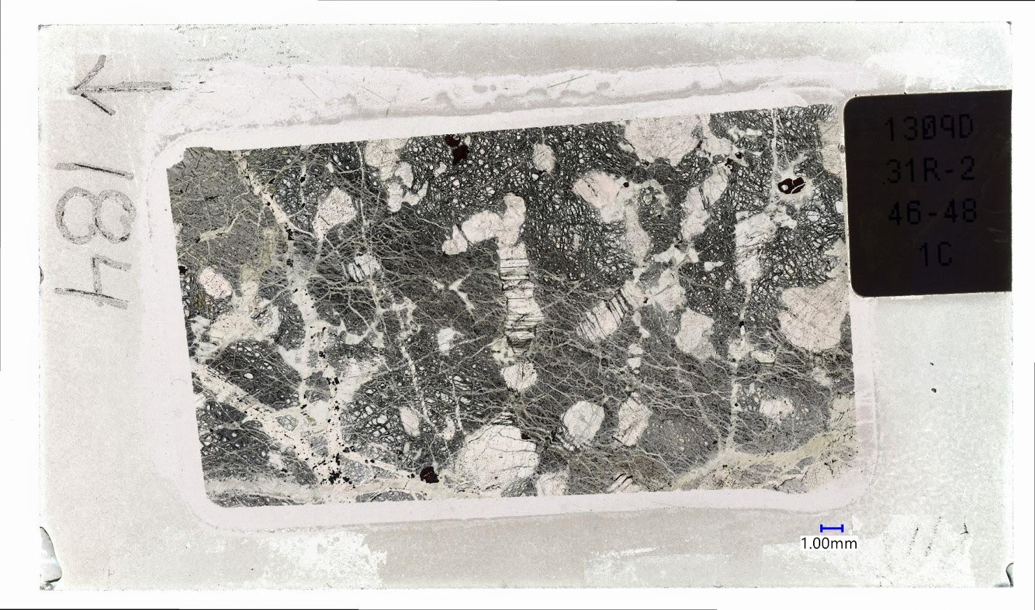
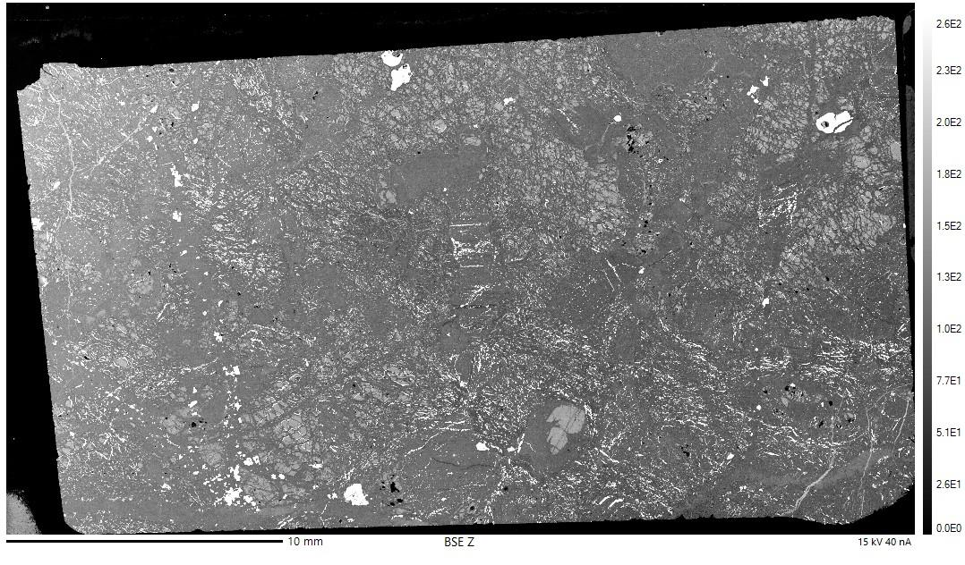
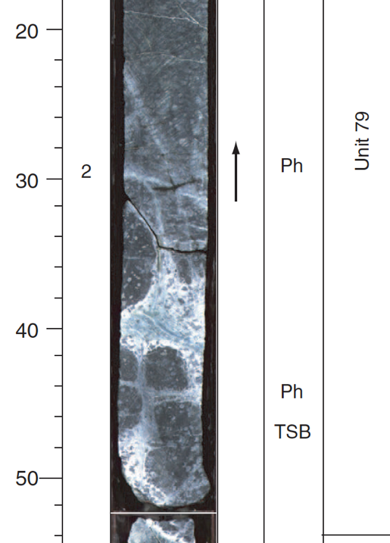
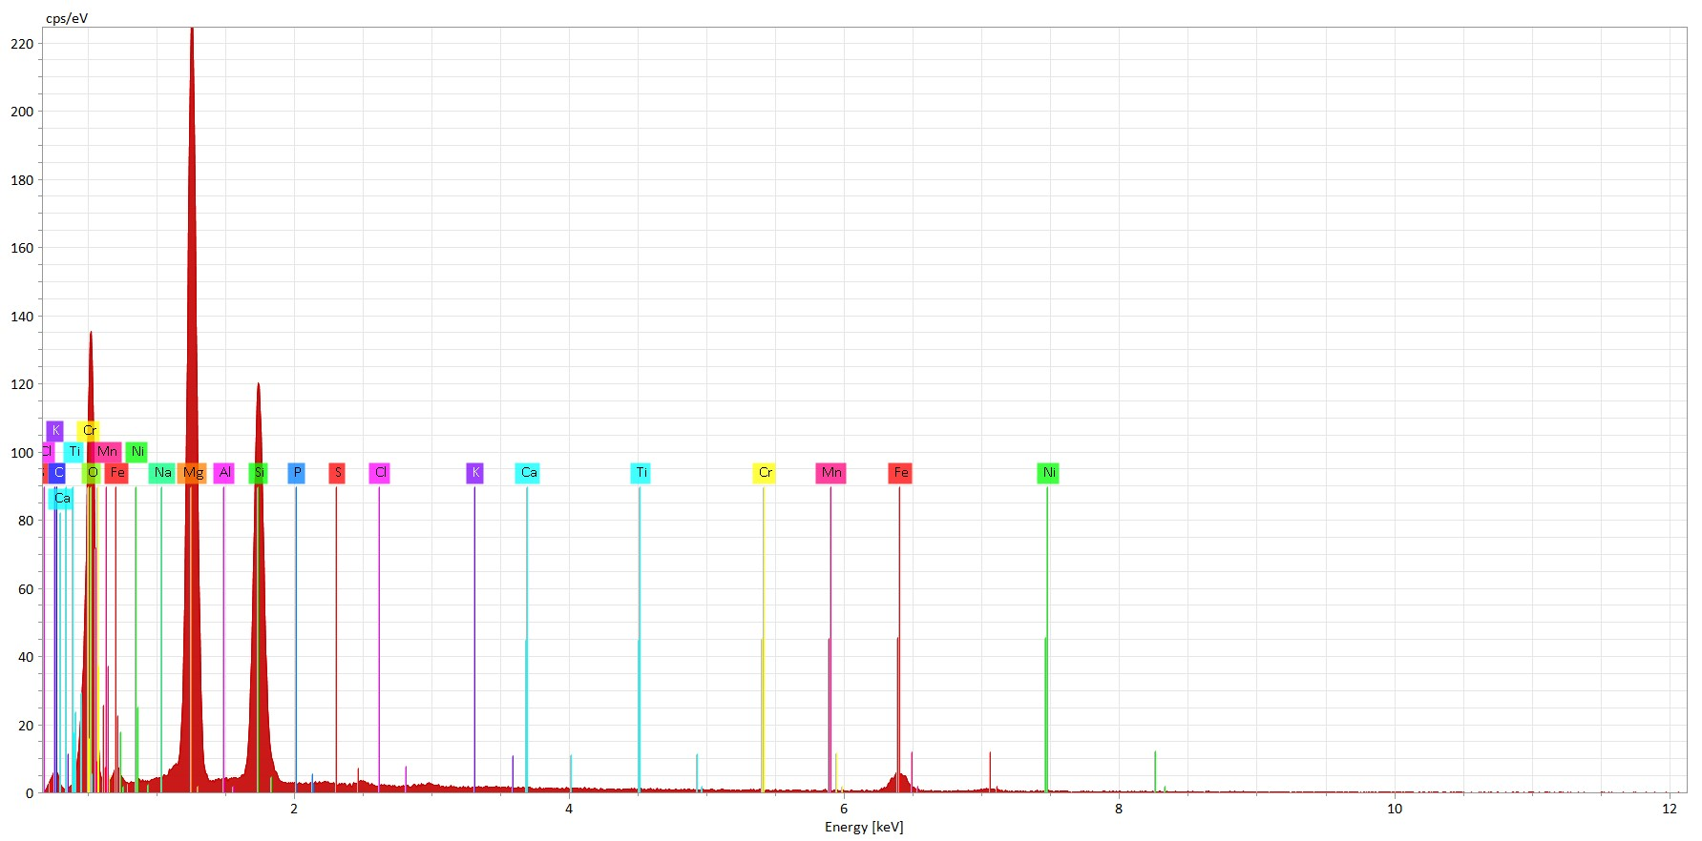
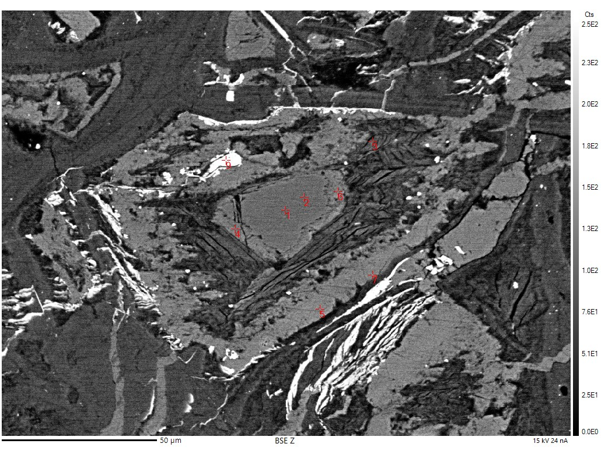
Methodology
4
Core from Site U1309
Sample: IODP 304-U1 1309D, 31R-2 Section 184
Thin Section
BSE Image
The Process
IODP drilled in Atlantis Massif
IODP made a thin section
Requested it
Carbon coated thin section
Put thin section into the microprobe, analyzed it
  BSE images – backscatter electron images
  EDS – energy dispersive spectroscopy
  WDS – wave dispersive spectroscopy
Source: K-ALFAA
Source: K-ALFAA
EDS of Olivine – high Mg and Si
Source: K-ALFAA
WDS - analysis points
Source: K-ALFAA
Source: IODP

Slide 5
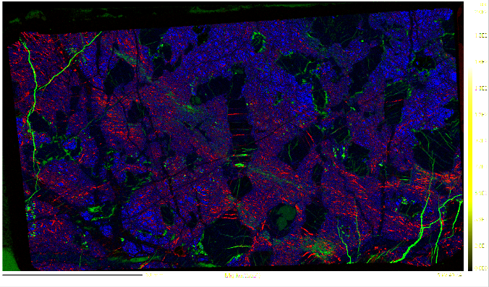
5
Carbonates – green Olivine – blue Sulfides - red
Source: K-ALFAA

Slide 6
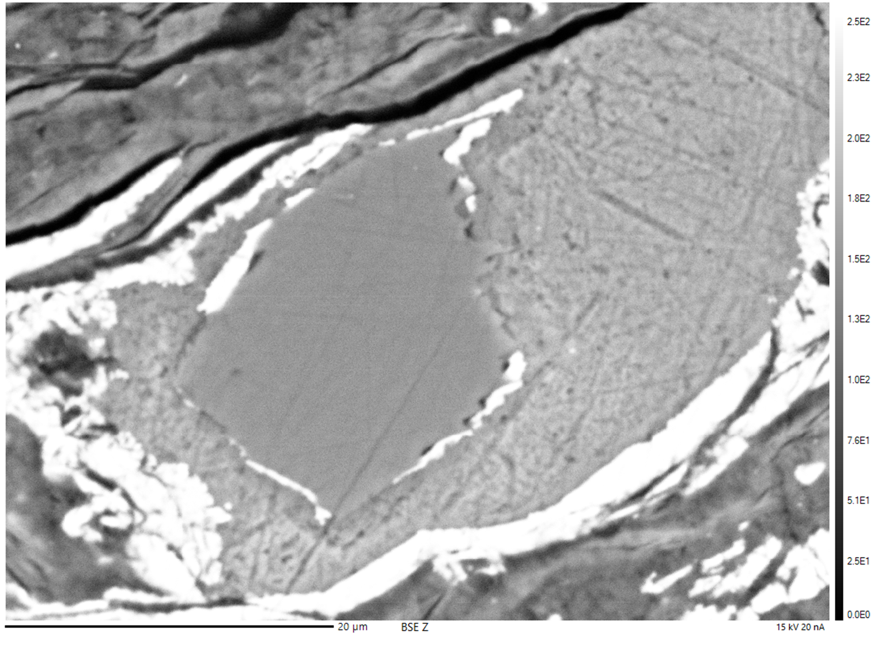
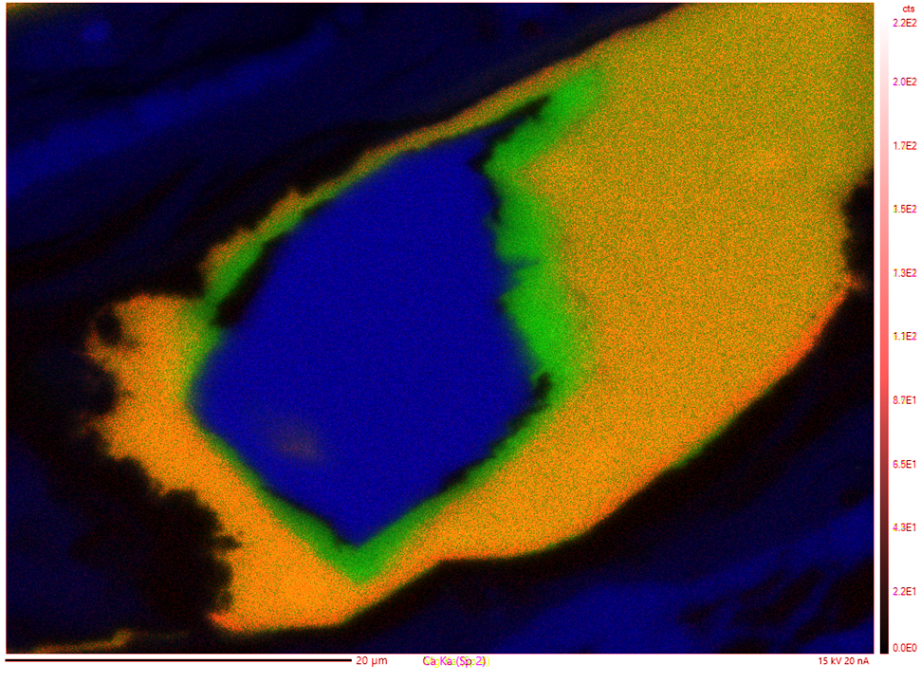
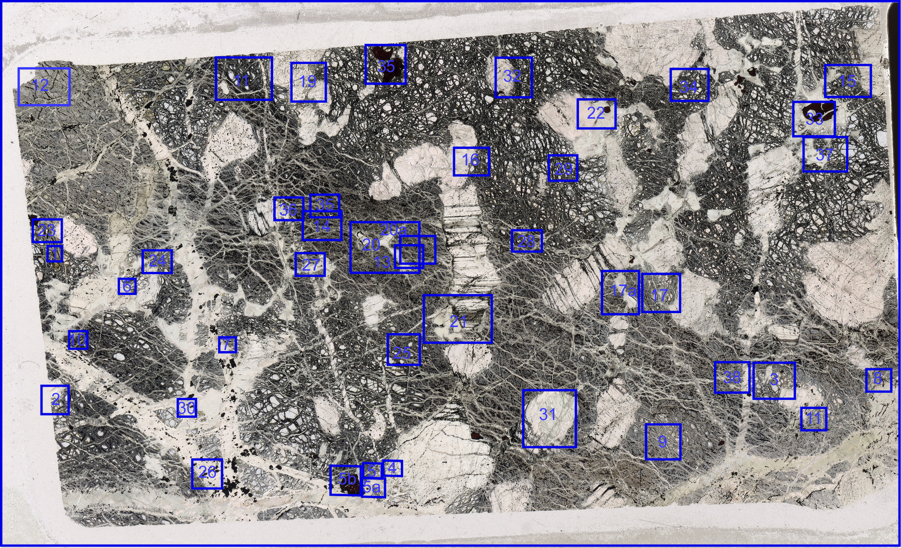
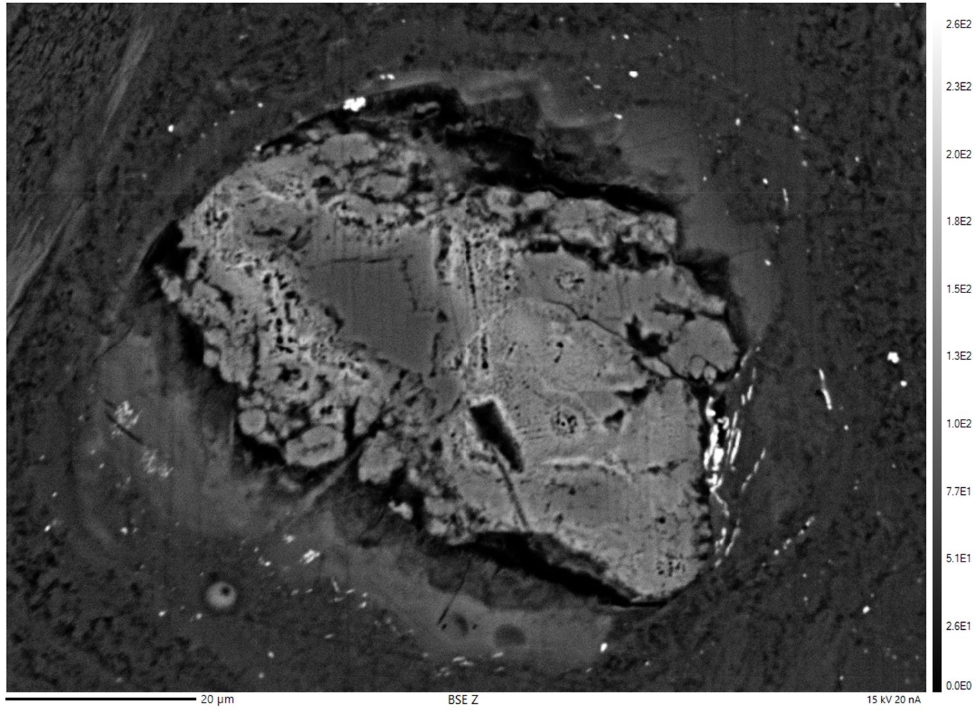
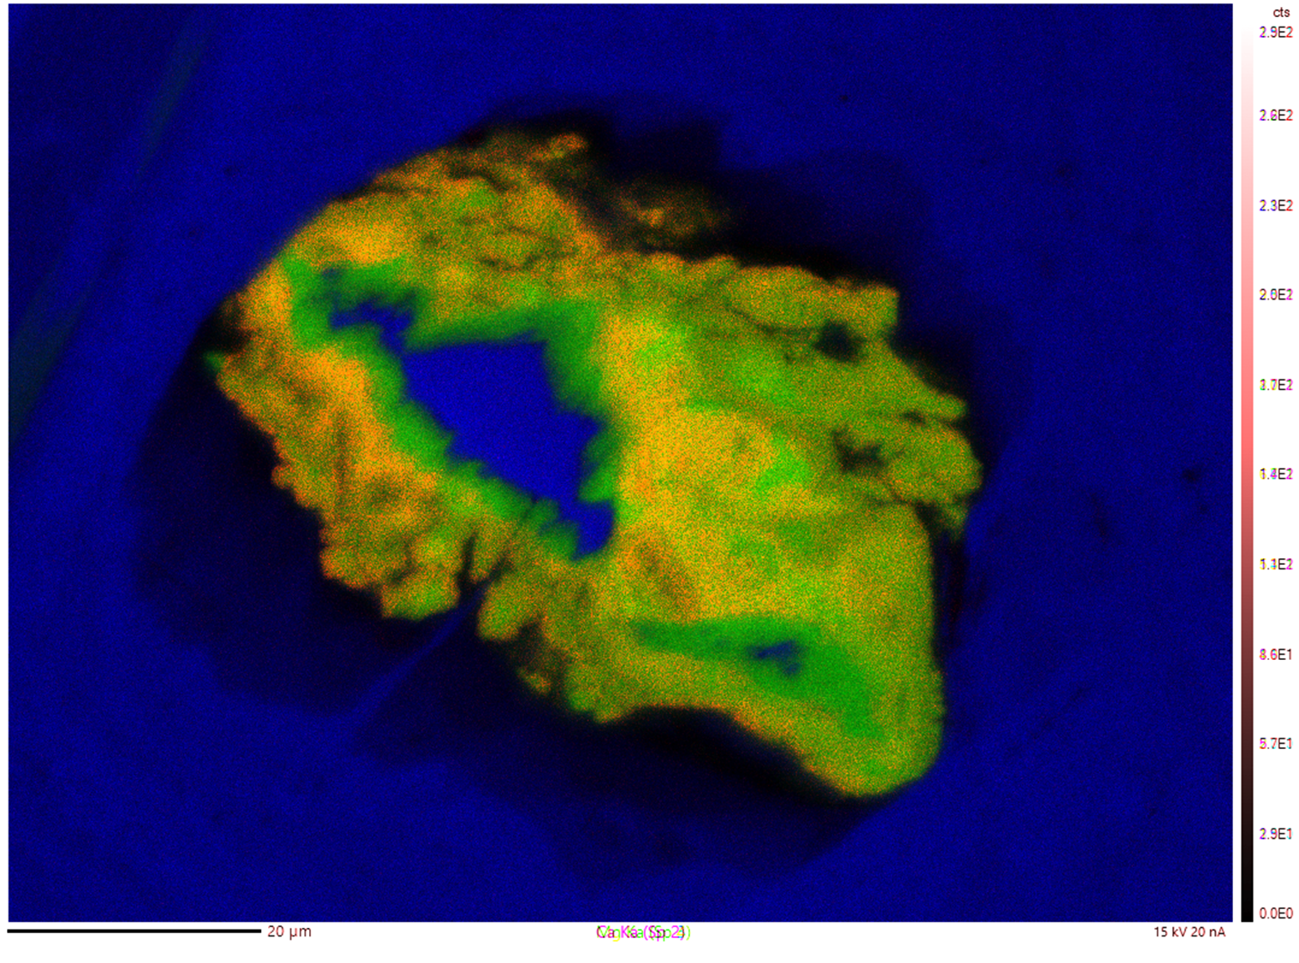
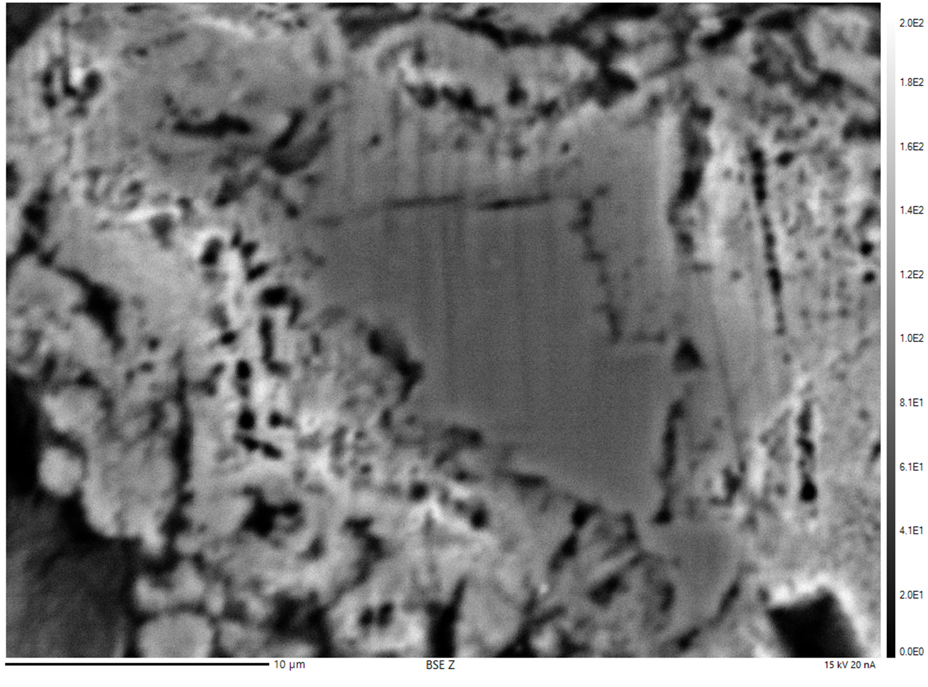
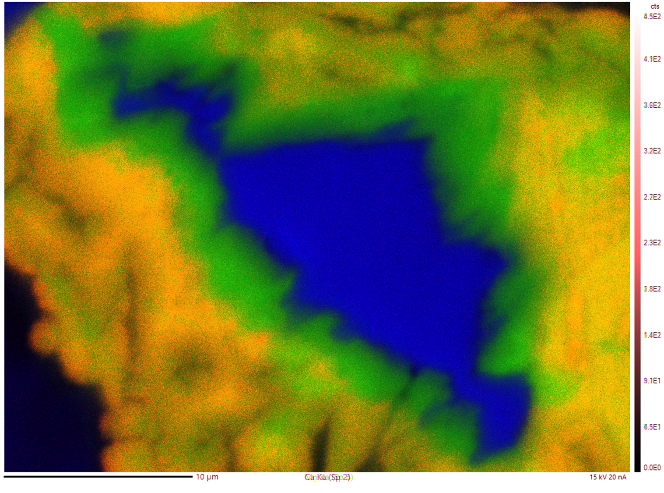
Identify Regions of Interest
6
BSE Images:
Mg – blue (Olivine)
Mn – red (Mn-rich carbonate)
Ca – green (Ca-rich carbonate)
MAP
Source: K-ALFAA

Slide 7
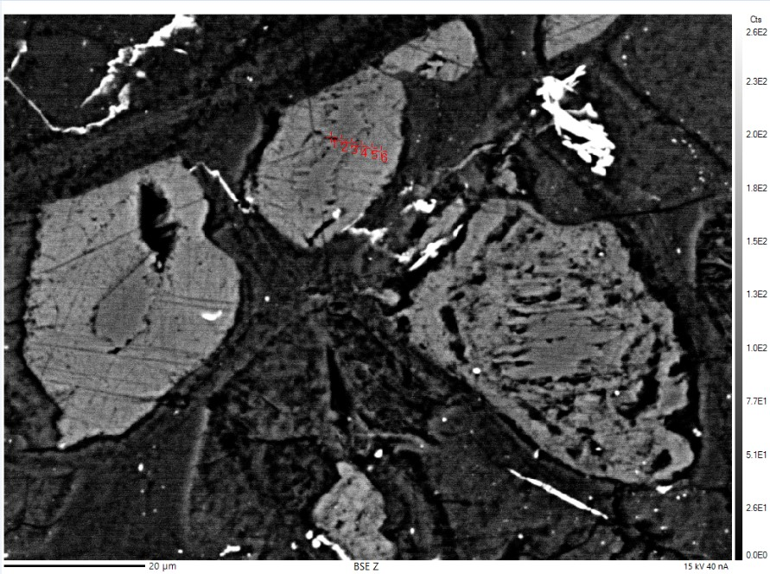
Olivine-Carbonate Reaction
7
CO2 dissolves into acidic solution
Olivine interacts with acidic fluid
Calcite (carbonate) precipitation
CO_{2(g)} + H₂O_{(l)} → H₂CO_{3(aq)}
Mg_{1.8}Fe_{0.2}Si₂O_{4(s)} → 1.8Mg²⁺_{(aq)}+ 2SiO_{2(aq)}
2HCO_{3(aq)}+ Ca²⁺_{(aq)} → CaCO_{3(s)} + H₂CO_{3(aq)}
Reactions assume initial fluid is rich in Ca and H₂S
Carbon Dioxide
Water
Carbonic acid
Source: K-ALFAA
Mg-rich olivine
Aqueous magnesium
Aqueous silicon
Bicarbonate
Aqueous calcium
Calcite
Carbonic acid

Slide 8
Implications
8
Olivine carbonation was observed.
CO2 bearing fluids are involved in the formation of olivine-carbonate assemblages.
Possible environmental conditions to form carbonates on Bennu using serpentinization at hydrothermal vents as an analog.
Store CO2 in an environmentally friendly way.

Slide 9
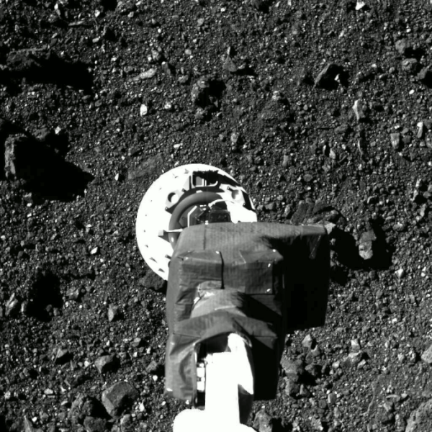
Future Work
9
Await sample return by OSIRIS-REx on September 24, 2023.
Source: NASA/University of Arizona

Slide 10
Acknowledgements
10
Thank you to Dr. Dante Lauretta, Melissa Kontogiannis, Ken Domanik, Dolores Hill, Space Grant, NASA’s OSIRIS-Rex Mission, University of Arizona Lunar and Planetary Sciences Laboratory (LPL), K-ALFAA and the International Ocean Drilling Project (IODP)

Slide 11
Thank you!
11

